Slide 1
The 2013 Target Data Breach
Group 1: Shivam Sinha, Yongxin Guo, Yuan Tan

Slide 2
Overview of the Target Data Breach
•• Date: November–December 2013
•• Affected 98 million customers' credit card details and PII
•• Cause: Vulnerabilities through a third-party vendor via phishing

Slide 3
Cybersecurity Lessons Learned
•• Vendor Risk Management
•• Network Segmentation
•• Real-Time Malware Detection
•• Incident Response

Slide 4
Future Prevention Strategies
•• Vendor Risk Management Plan
•• Advanced Malware Detection Systems
•• Comprehensive Incident Response Plan

Slide 5
Identify: Key Failures
•- Weak vendor management allowed unauthorized access.
•- Insufficient risk assessments of third-party partners.

Slide 6
Protect: Key Failures
•- Lack of network segmentation enabled lateral movement.
•- Payment data was not adequately encrypted.

Slide 7
Detect:Execution of the Vulnerability Management Plan
1.Regular Auditing of the Vulnerability Management Plan
2. Tabletop Exercises for Inactive Portions
3. Functional Exercises Every Six Months

Slide 8
Respond:Execution of the Incident Response Plan
Monthly Audits
Tabletop Exercises for Unused Portions
Functional Exercises Every Six Months
Immediate Isolation of Affected Systems
Incident Containment Procedures
Forensic Analysis and Incident Investigation
Involvement of Cybersecurity Experts
Communication Protocols
Internal Escalation Procedures

Slide 9
Recover :Execution of Incident Recovery Plan
Audits and Testing
Monthly Audits: Regular audits ensure recovery plans are up to date and effective.
Tabletop Exercises: Simulate incident scenarios for portions of the plan that haven’t been used recently.
Functional Exercises (Every 6 Months): Simulate real-world cyberattacks to assess the readiness of recovery systems.
Key Actions
Data Restoration: Verify the integrity of backups and ensure data can be fully restored.
System Recovery: Ensure affected systems are securely restored to operational status.
Process Improvement: Post-incident analysis to enhance recovery processes for future incidents.

Slide 10
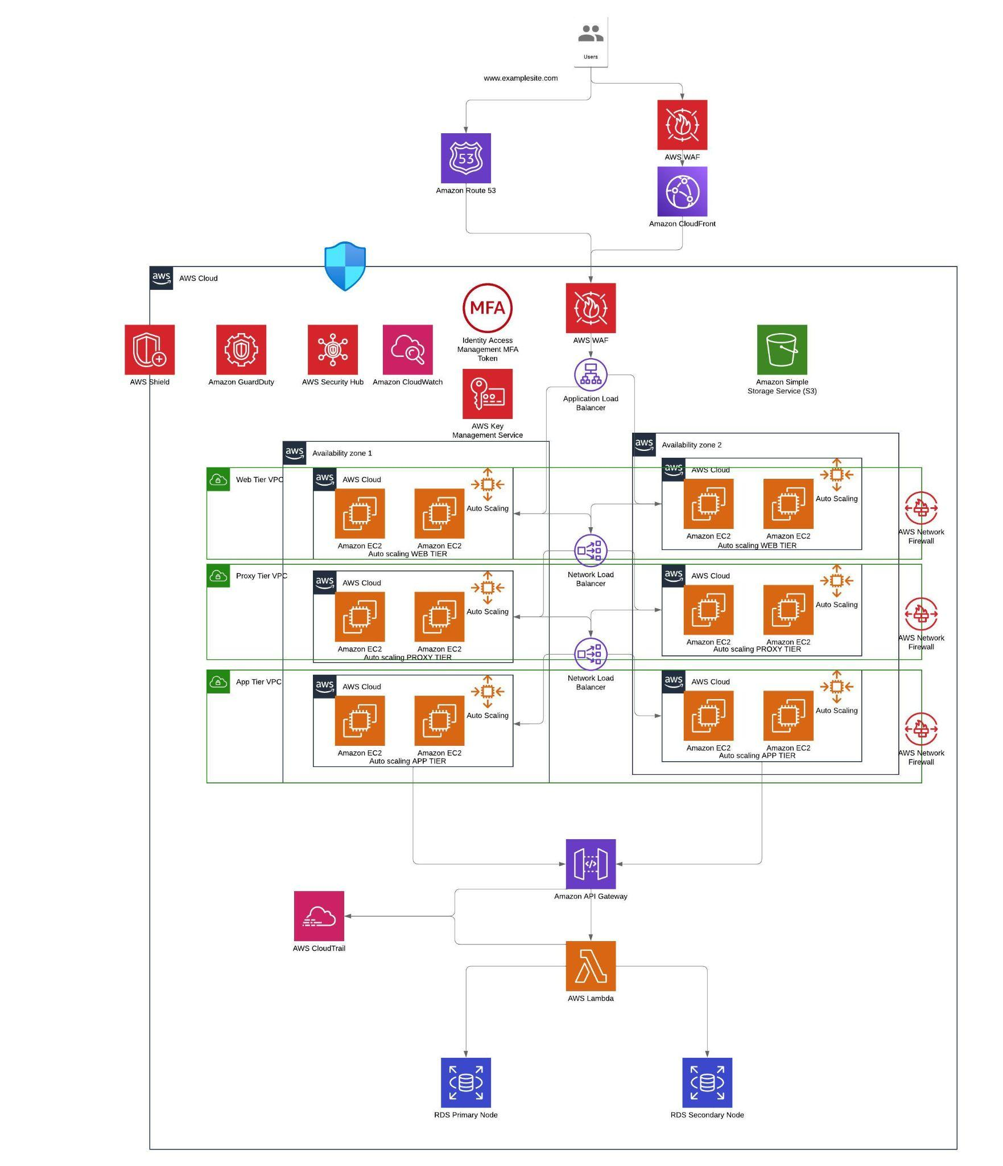
AWS Architecture
AWS WAF (Web Application Firewall): Protects against common web exploits like SQL injection and cross-site scripting.
AWS Shield: Provides DDoS protection, safeguarding against volumetric and network layer attacks.
Amazon GuardDuty: Continuous threat detection using machine learning to identify anomalies and unauthorized activities.
AWS Security Hub: Centralized security management, combining data from multiple services for a unified view of security posture.
Amazon CloudWatch: Real-time monitoring for logging, alarming, and alerting on security and operational metrics.
AWS KMS (Key Management Service): Provides data encryption and secure key management for sensitive data.
Auto Scaling with Secure EC2: Automatically scales instances while maintaining security configurations.

Slide 11
Services
Here's a list of the AWS services used:
Amazon Route 53 – For DNS and domain management.
Amazon CloudFront – For content delivery network (CDN) to deliver web content globally.
AWS WAF (Web Application Firewall) – For protecting web applications from common threats like SQL injection and cross-site scripting (XSS).
Amazon S3 – For static content storage, like website files.
Amazon EC2 – For scalable compute instances, across web, app, and proxy tiers.
Amazon RDS (Relational Database Service) – For managing relational databases (e.g., MySQL, PostgreSQL).
Amazon API Gateway – For creating, publishing, maintaining, monitoring, and securing APIs.
AWS Lambda – For running backend functions and microservices without provisioning servers.
Amazon GuardDuty – For threat detection using machine learning and anomaly detection.
AWS Security Hub – For unified security checks and insights.
Amazon CloudWatch – For monitoring and observability of cloud resources and applications.
AWS Key Management Service (KMS) – For encryption key management.
Auto Scaling – For automatically scaling EC2 instances in response to load.
Application Load Balancer – For distributing incoming traffic across EC2 instances.
Network Load Balancer – For handling high throughput and connection-based traffic.
VPC (Virtual Private Cloud) – For network segmentation into web, app, and database tiers.
AWS Network Firewall – For filtering traffic between VPCs and controlling ingress/egress traffic.
AWS CloudTrail – For logging all API calls and actions across AWS services.
IAM (Identity and Access Management) with MFA – For user authentication and enforcing Multi-Factor Authentication for privileged access.

Slide 12
Reflection learning
Integration of AWS Services with NIST Framework
Importance of Network Segmentation and Access Controls
Real-time Monitoring and Incident Response
Multi-layered Defense Approach

Slide 13
Next steps
Explore Enhanced Vendor Risk Management
Implement Automated Incident Response
Conduct Regular Security Audits and Penetration Testing
Expand to Serverless Architectures
User Awareness and Training

Slide 14
References
•• Krebs, B. (2014). Inside Target Corp. Days After 2013 Breach.
•• Smith, B. (2015). The Target Data Breach and Lessons Learned.
•• Yao, D., & Wang, Z. (2014). Target Data Breach Case Study.

